Slide 1


Spotly Elite
Presented By,
1.Abiyayuna Daniel
2.Raghul V
3.Sandhiya S
4.Suganthi Stephen
5.Sridhar K
6.Venkatesa Perumal S
Comprehensive Rental Website

Slide 2
Problem Statement
In the current rental market, there is a significant gap in providing a seamless, transparent, and efficient platform for renting home, workspaces, PG accommodations, empty lands, and plots.
Existing platforms often suffer from issues such as outdated property listings, lack of real-time availability, poor communication between renters and owners, and insufficient information to make informed decisions.
These challenges lead to frustration for both property owners and renters, resulting in missed opportunities and inefficient use of available properties.

Slide 3
Objective
Develop an advanced, user-friendly platform that efficiently connects property owners with potential renters.
Revolutionize the rental market for home, workspaces, PG accommodations, empty lands, and plots.
Address existing challenges and enhance the overall rental experience.

Slide 4
GOALS
Launch a Full-Featured Rental and Purchase Platform
Achieve High User Satisfaction
Ensure Data Security and Privacy
Expand Property Listings
Optimize Operational Efficiency
Establish Market Presence

Slide 5
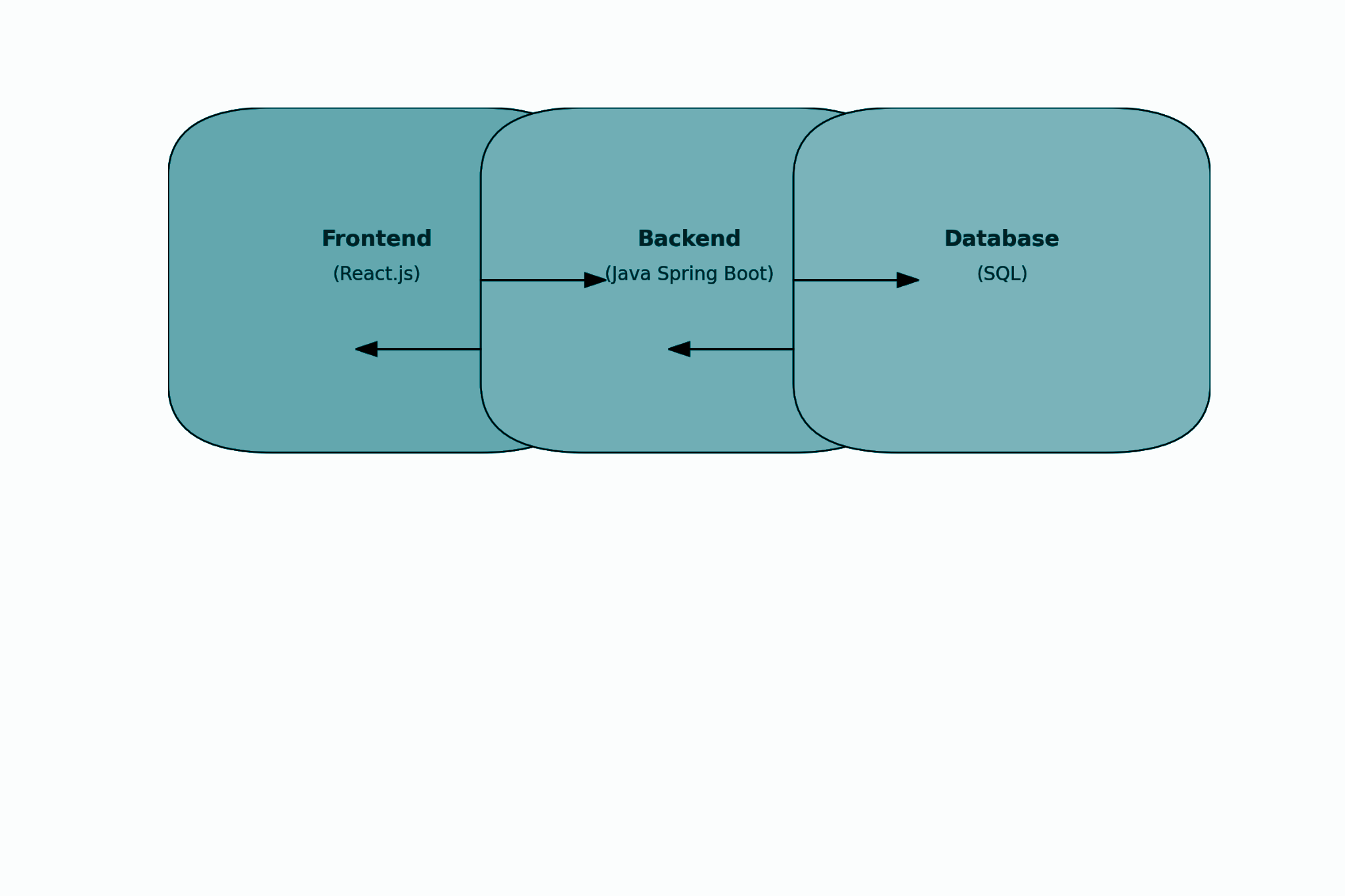
System Architecture

Slide 6
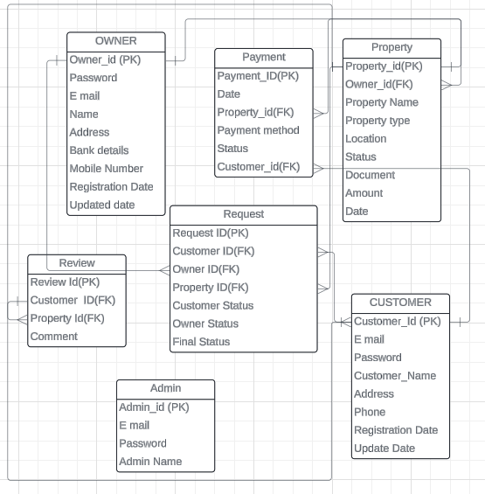
Database Design

Slide 7
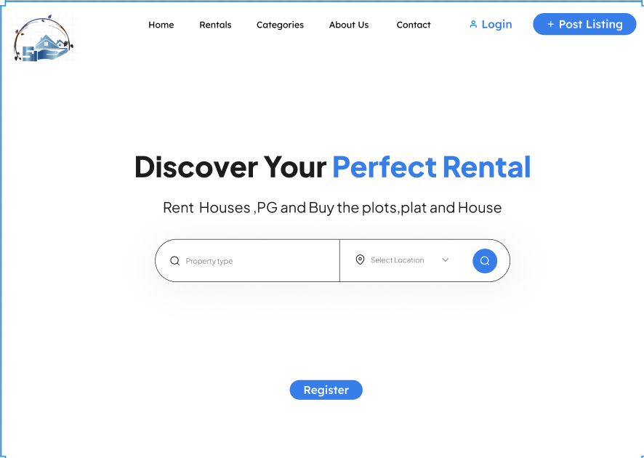
UI /UX Design
HOME PAGE

Slide 8
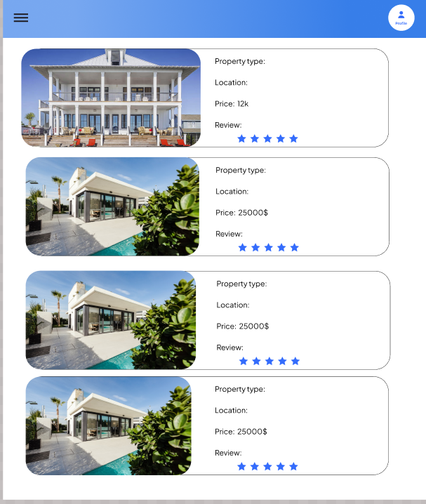
PROPERTIES PAGE

Slide 9
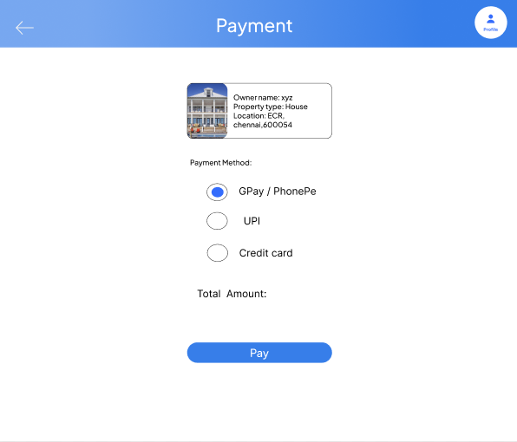
PAYMENT PAGE

Slide 10
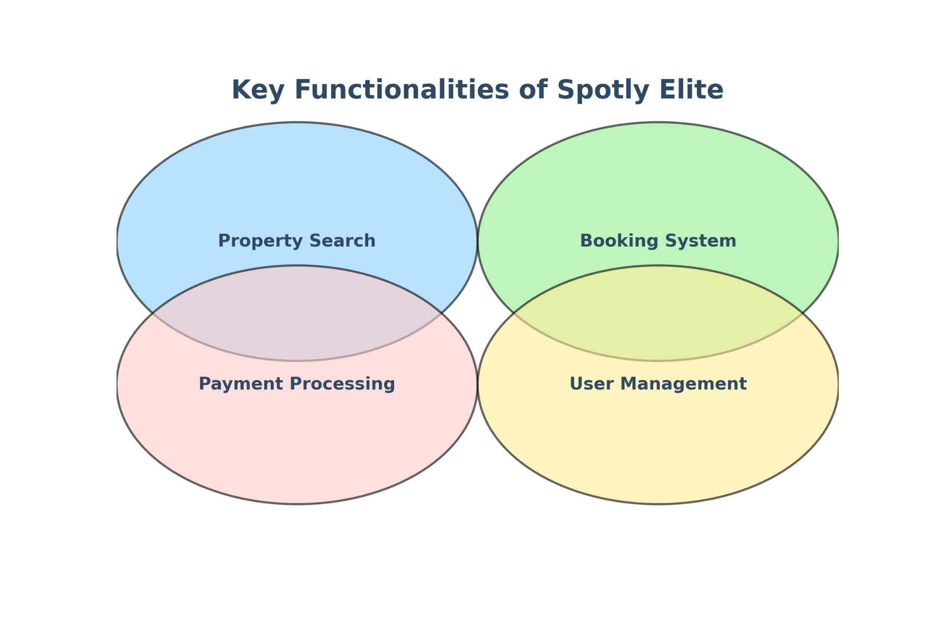
Key Functionalities

Slide 11
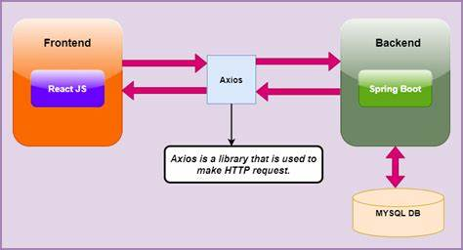
TECHSTACKS

Slide 12
Spring Boot
Spring Initializer
Json Ignore
Params
Lombok
JPA Query Methods

Slide 13
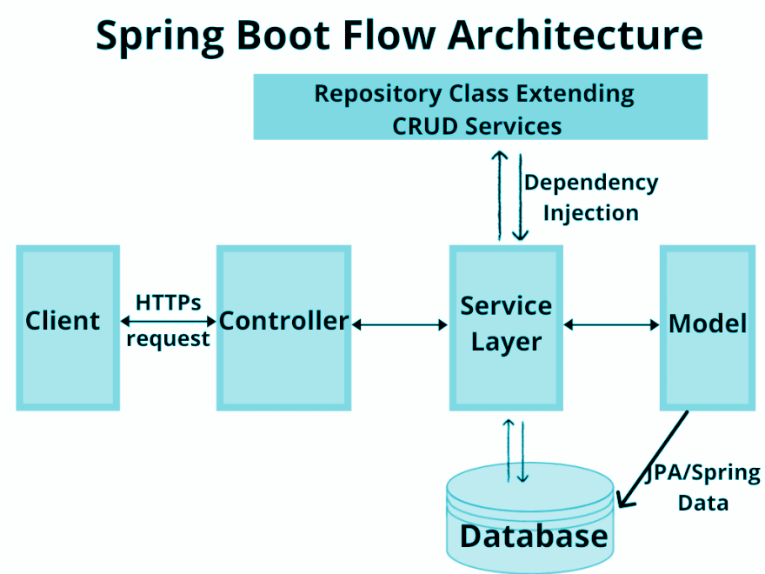
Springboot

Slide 14
React JS
Framework: React with Vite
Using React Hooks and Context API
Use Effects
React Router for navigation
CSS modules and external CSS files
MUI Components (Tabs)

Slide 15
Conclusion
Spotly Elite bridges rental market gaps with a seamless, efficient platform. It addresses outdated listings, communication issues, and real-time availability, enhancing the rental experience for homes, workspaces, PG accommodations, and plots. By maximizing property utilization and user satisfaction, Spotly Elite revolutionizes the rental market. Continuous innovation ensures our platform remains cutting-edge.

Slide 16
THANK YOU!

